Slide 1
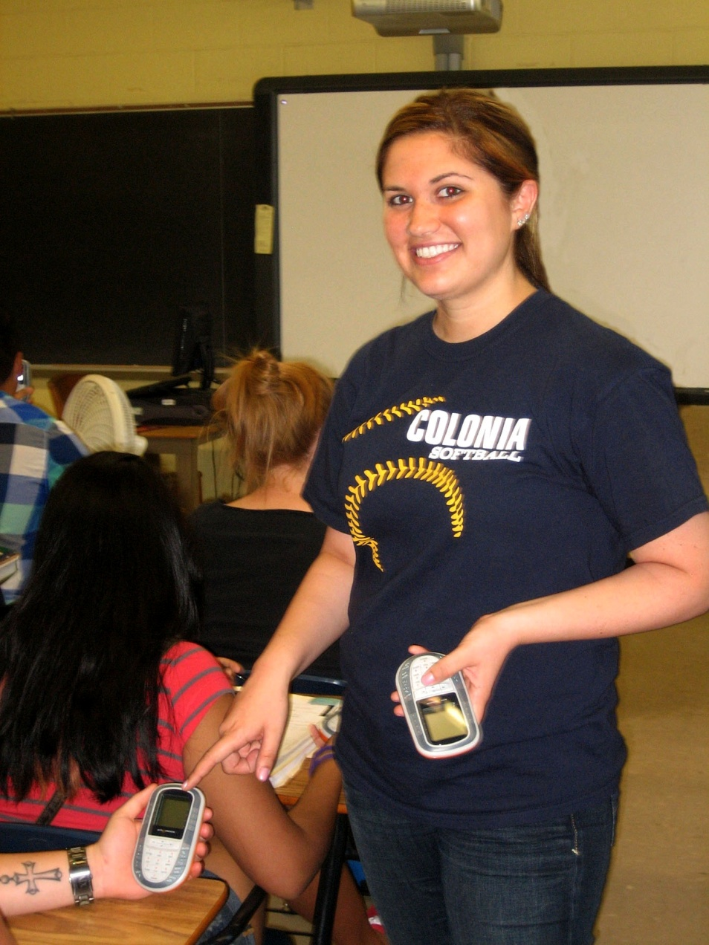
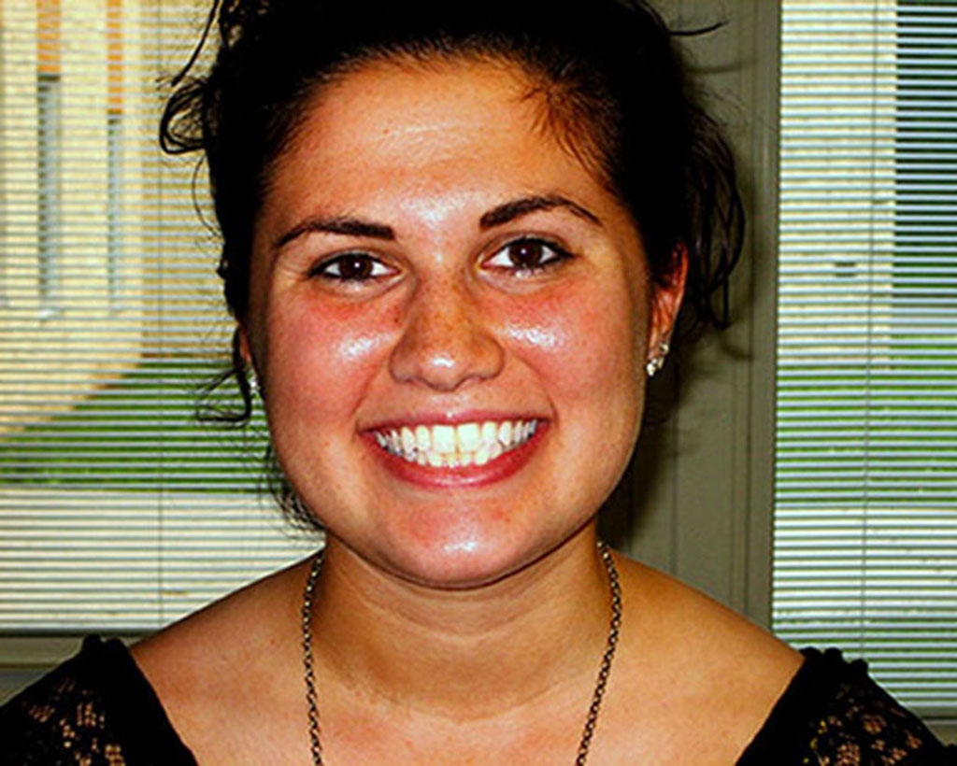
Jennifer Corrigan
Instructional Media 7005

Slide 2
Subject
The subject of my portraits is one of my fellow colleagues , Meaghan Joyce. I chose to photograph Meaghan because she shares my passion for teaching and instructional technology . Meaghan is currently earning her masters degree in Instructional Technology from Ramapo College of New Jersey (where I earned my undergraduate degree). Since Meaghan and I share a love of learning and especially of integrating the latest technologies into our instructional practices I believe she would be an ideal subject to photograph for this assignment.

Slide 3
Portrait Descriptions
The environmental portrait depicts Meaghan in her everyday teaching atmosphere. Meaghan and I work at Colonia High School in Colonia, New Jersey, which is part of the Woodbridge Township School District. Meaghan utilizes the smart board daily as well as the Promethean board student responders (“clickers”) to engage and motivate her students. Meaghan is a strong advocate of incorporating technology into her teaching practices in order to stimulate her student’s learning experiences. Using the student responders as a form of assessment enables Meaghan to see if her students are comprehending the content. She also takes the necessary time to prepare “flipcharts,” which are the instructional slides portrayed in the Active Inspire Promethean smart board software program.
The close-up portrait accurately portrays Meaghan’s warm and friendly personality, as well as her positive mood.

