Slide 1
edd 7914 Curriculum Teaching and technology group 2: Jennifer Corrigan and Verona Campbell
Pinterest: An Emerging Technology

Slide 2
What is Pinterest?
• Website that allows you to “pin” things online similar to a real-life bulletin board
• Pins are visual bookmarks for ideas found on the web or directly on Pinterest
• Pins can range from ideas pertaining to recipes, fashion, technology, books, celebrities, art, gardening, and much more.
•“Boards” are meant for gathering pins by theme or topic
• Find friends and repin

Slide 3
Pinterest in Education
• Pinterest is a great website to get ideas on almost anything. This emerging technology is extremely useful and very user friendly.
Education
Lesson Plans
Sharing Ideas
Organization
Student Use

Slide 4
How Educators Use Pinterest?
Organize educational ideas
Collaborate with other educators
Collaborate with other students on Pinterest
Create boards for each subject or topic
Pin info-graphs or videos which cover a subject or topic

Slide 5
Jennifer Corrigan’s Pinterest Lesson
College Planning Board
How to create a board
How to “pin” / 10 pins
Friend one another on pinterest
Did it work?
Responses from learners
Learning curve

Slide 6
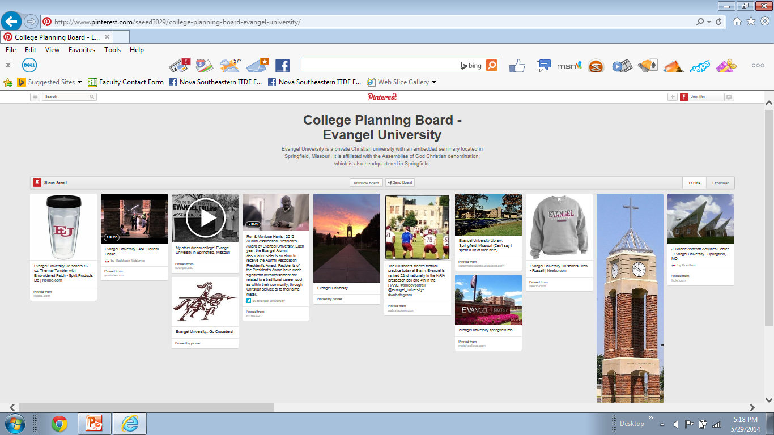
Screen shot of a student’s College Planning Board

Slide 9
VERONA CAMPBELL’S PINTEREST LESSON
WHAT PINTEREST DOES?
HOW DID I USE IT?
HOW DID IT WORK TO ACCOMPLISH MY OBJECTIVES ?
WHAT TO DO DIFFERENTLY NEXT TIME?

Slide 10
Pinned Activity Flowering Plants

Slide 11
Pinned Activity Non Flowering Plants

Slide 12
Summary
Good Instructional Tool
Pros
Cons

Slide 13
References
Kavulla, K. (2012). Pinterest: What it is, how to use it and why you’ll be addicted. Retrieved from http://www.sheknows.com/living/articles/852875/pinterest- what-it-is-how-to-use-it-and-why-youll-be- addicted
Morrison, A. (2011). Pearson School System. Retrieved from
http://www.pearsonschoolsystems.com/blog/?p=424/#sthash.8xe XT5Zf.dpbs

